Slide 1
Job Tracking.

Slide 2
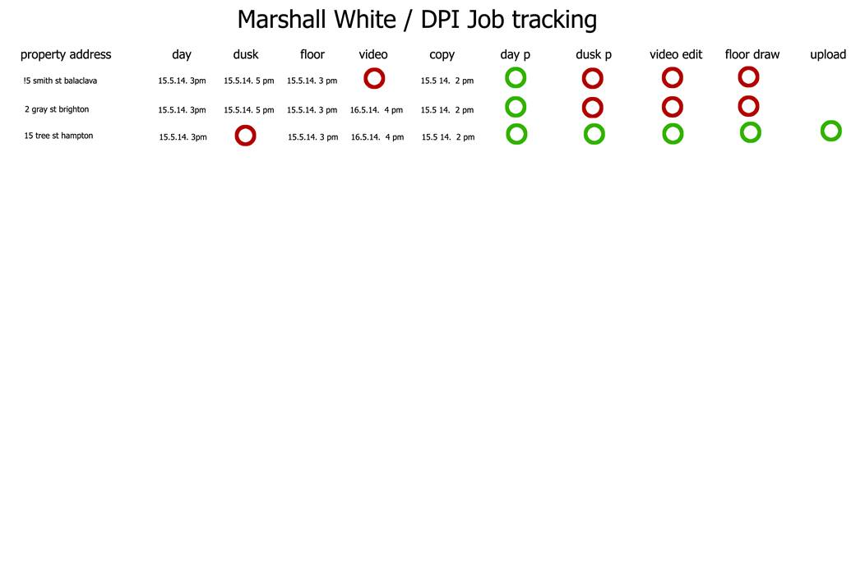
Clients original request.
1. the ct order will generate an entry listed as an address
2. when the jobs are dragged from the staging calendar, the form will take the calendar entry date and time
3. when the dpi staff responsible for the processing or editing, have completed the job, they will edit the form and update.
4. the form needs to update every 5 minutes or so
5. if the address does not have a product ordered , a red button appears ie no video ordered mean a red button in place of the date and time
6. the list of address must be in chronological order
7. there needs to be a search function available

Slide 3
Explanation
Order is received by CT-DPI email, and Events are created in the staging calendar. These are ‘Jobs’, which will have inside the description field an OrderId, and ProductGroupID and Name.
During the email receive process, we will create a new step to Create the record in Job table.
The scheduler (user) will move these events using OMS to individual calendars.
I will write a SQL routine which runs every 5 mins to query the Events table for OrderId and ProductID and I will insert these into the JobEvents table.
This Job tracking from will read off the Job and Job events table, to display which ProductGroup has been ordered and what time the Event is scheduled for, for a specific address. I will write this SP.
The internal users have the ability to upload Photos, or words (copywriting) once the job has been done and mark as completed.
Photos will go into Job Attachments
Copy will go into JobCopy

Slide 4
Eg.
Select PG.Name as Service,
J.Title,
LTRIM(RIGHT(CONVERT(VARCHAR(19),JE.STARTDATE),8))
from Job J inner join [dbo].[JobEvents] JE on J.row_Id = JE.Job_Id inner join ProductGroups PG on JE.ProductGroupId = PG.Row_Id

Slide 5
I have created some tables.
Job -- Where we would store the Jobs
JobAttachments -- Where the uploads will go for Jobs
JobCopy -- Where the copywriting uploads will go
JobCopyType -- The type field for Copywriting uploads.
JobEvents -- The allocated Events of the Jobs
JobStatus -- The status of the Job and storing changes to the Status.

Slide 6
Job Tracking
The Job tracking form is primarily for External Users (Clients) to see the status of their Orders. External Users will not have any edit functions, just read only of the status’ in the list and constrained to the orders that they have sent.
Internal Users, have the ability to interact with the list, update status’ and also upload the digital assets that have been produced as a result of the job.

Slide 7

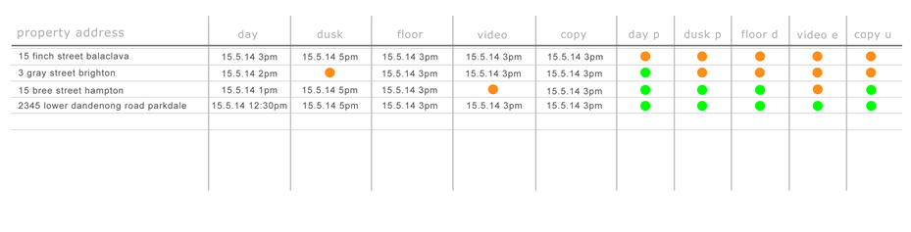
Contacts
Job Tracking
Home
Companies
Products
Contacts
Orders
Scheduler
Job Tracking
All Jobs
My Jobs

Slide 9

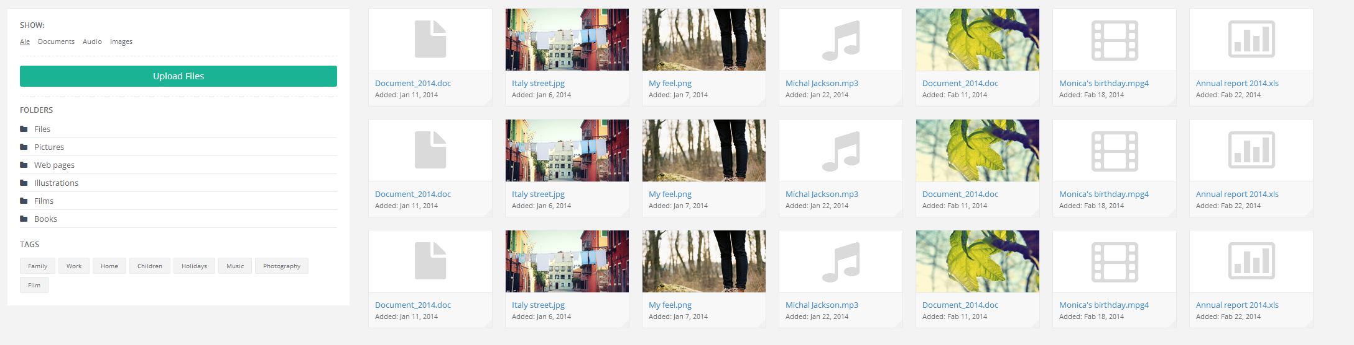
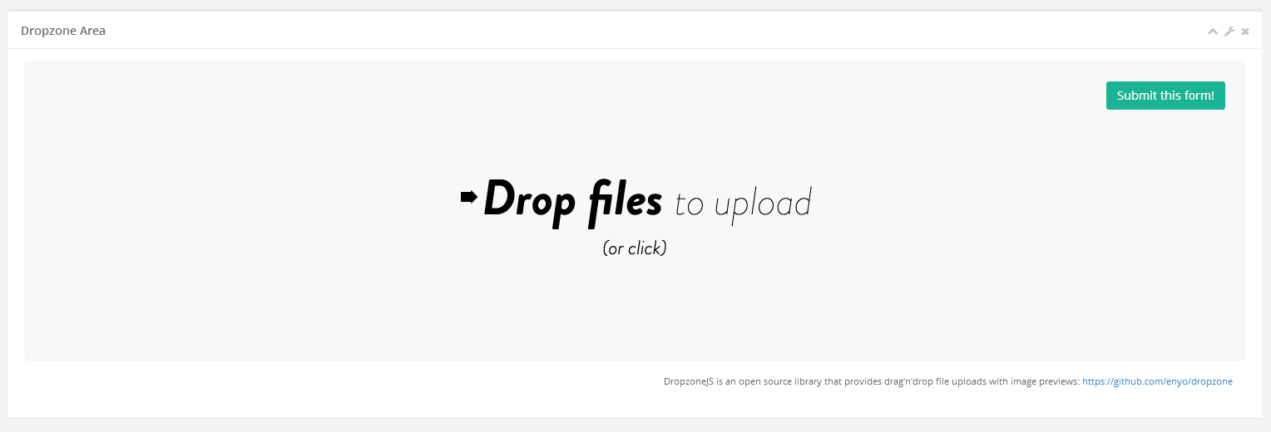
Internal User
When clicking on the icon for photography (day/dusk)
It should allow the user to upload pictures and mark this activity
Off as complete.
15 Finch Street Balaclava: Photography - Day
Status
Complete

Slide 10
Create a new table to store the attachments. JobAttachments Row_Id int pk Order_Id int fk to t_order.row_id Org_Id int fk to organisation.row_id FileName varchar(255) FileExtension varchar(5) FileSize int File image Type varchar(100) values Photo Day, Photo Dusk, Video, Copywriting, Floorplan Folder varchar(100) Created datetime CreatedBy int Updated datetime UpdatedBy int

Slide 11
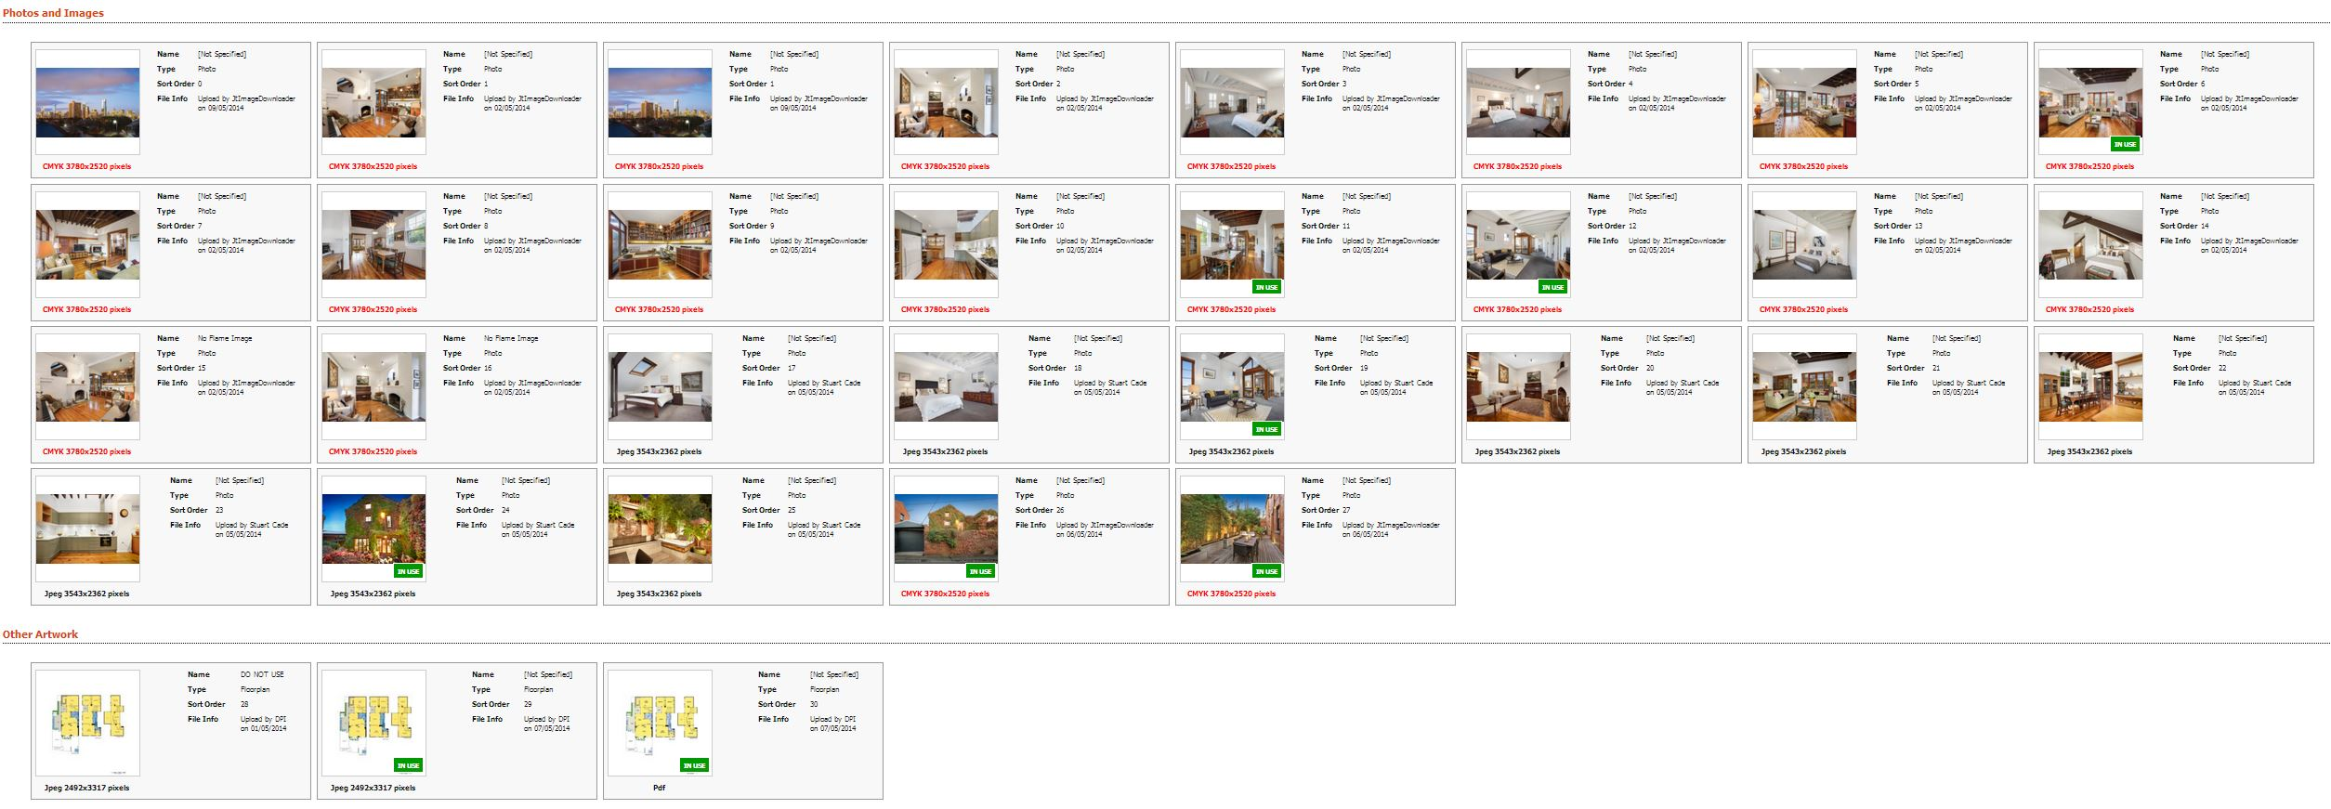
This is a gallery of images that have been uploaded. Divided by Type. This is how campaigntrack does it.

Slide 12
Create a new table. This will store the content if the service was for copywriting. OrderContent Row_Id int pk Order_Id int fk to t_order.row_id Org_Id int fk to organisation.row_id AdCopySub_Title vachar(max) AdCopySub_Body vachar(max) Signboard_Title vachar(max) Signboard_Body vachar(max) Brochure_Title vachar(max) Brochure_Copy vachar(max) AdCopyMetro_Title vachar(max) AdCopyMetro_Body vachar(max) Other_Title vachar(max) Other_Body varchar(max)

Slide 13
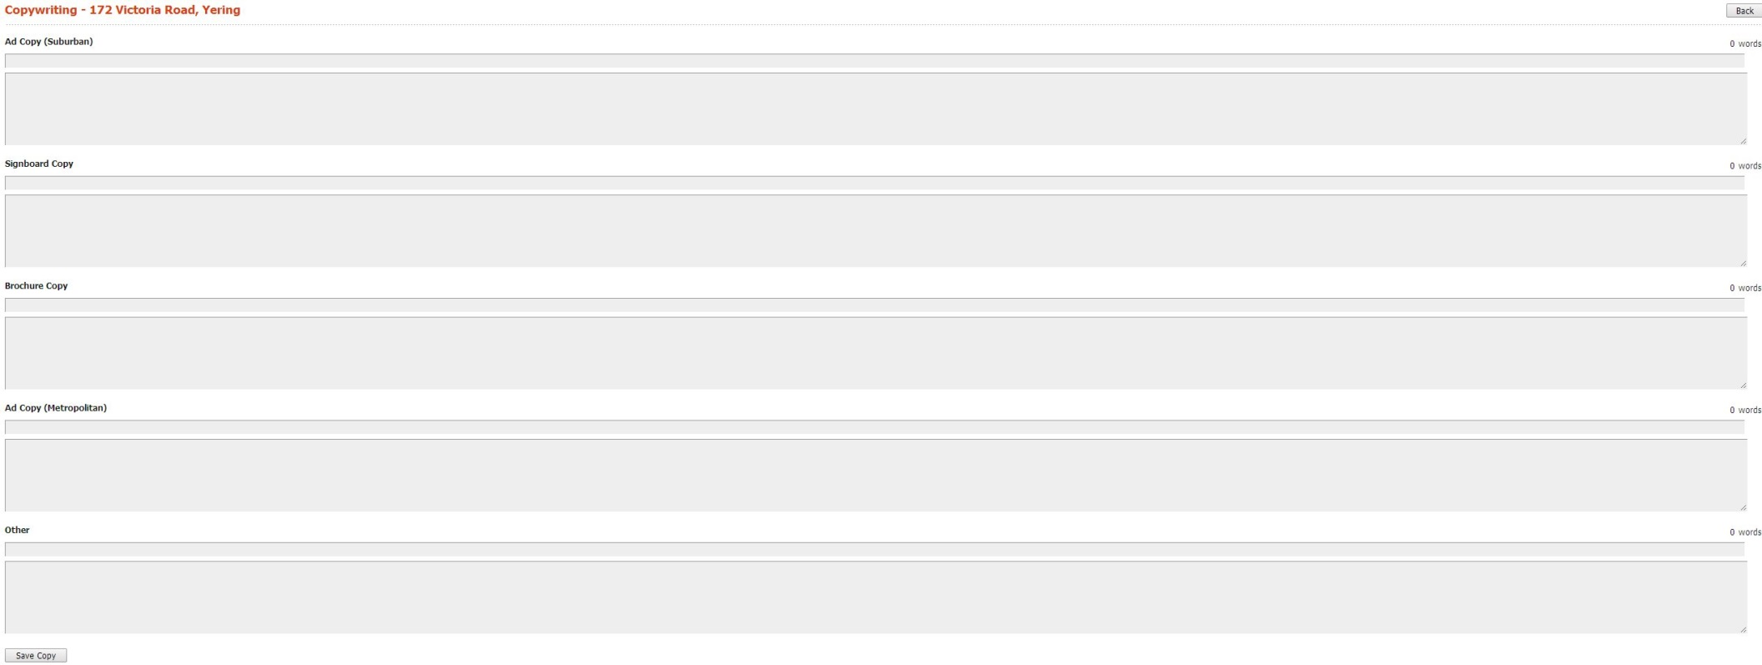
When clicking on the icon for copywriting
It should allow the user to upload content and mark this activity
Off as complete.
15 Finch Street Balaclava: Copywriting
Status
Complete

Slide 14
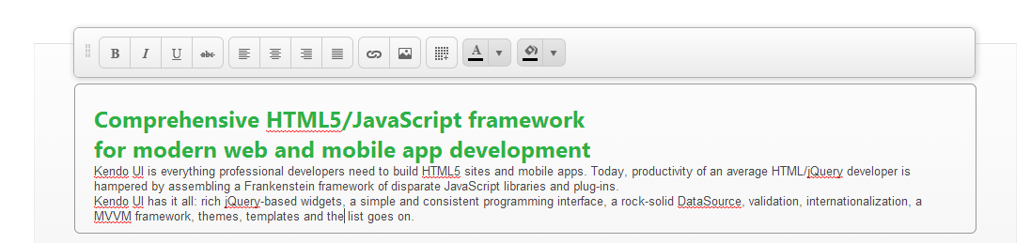
We should use the telrik inline editor for each of the content boxes.
http://demos.telerik.com/kendo-ui/editor/inline-editing

Slide 15
This is the standard design for Boostrap. I think we should use this as a starting point.

Slide 16
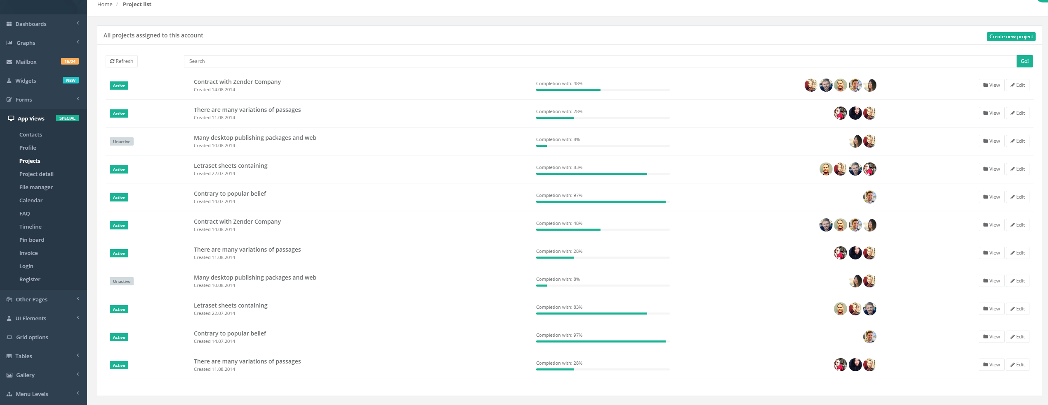
This is the project list. Can we have a UI designer try and merge these two concepts?

Slide 17
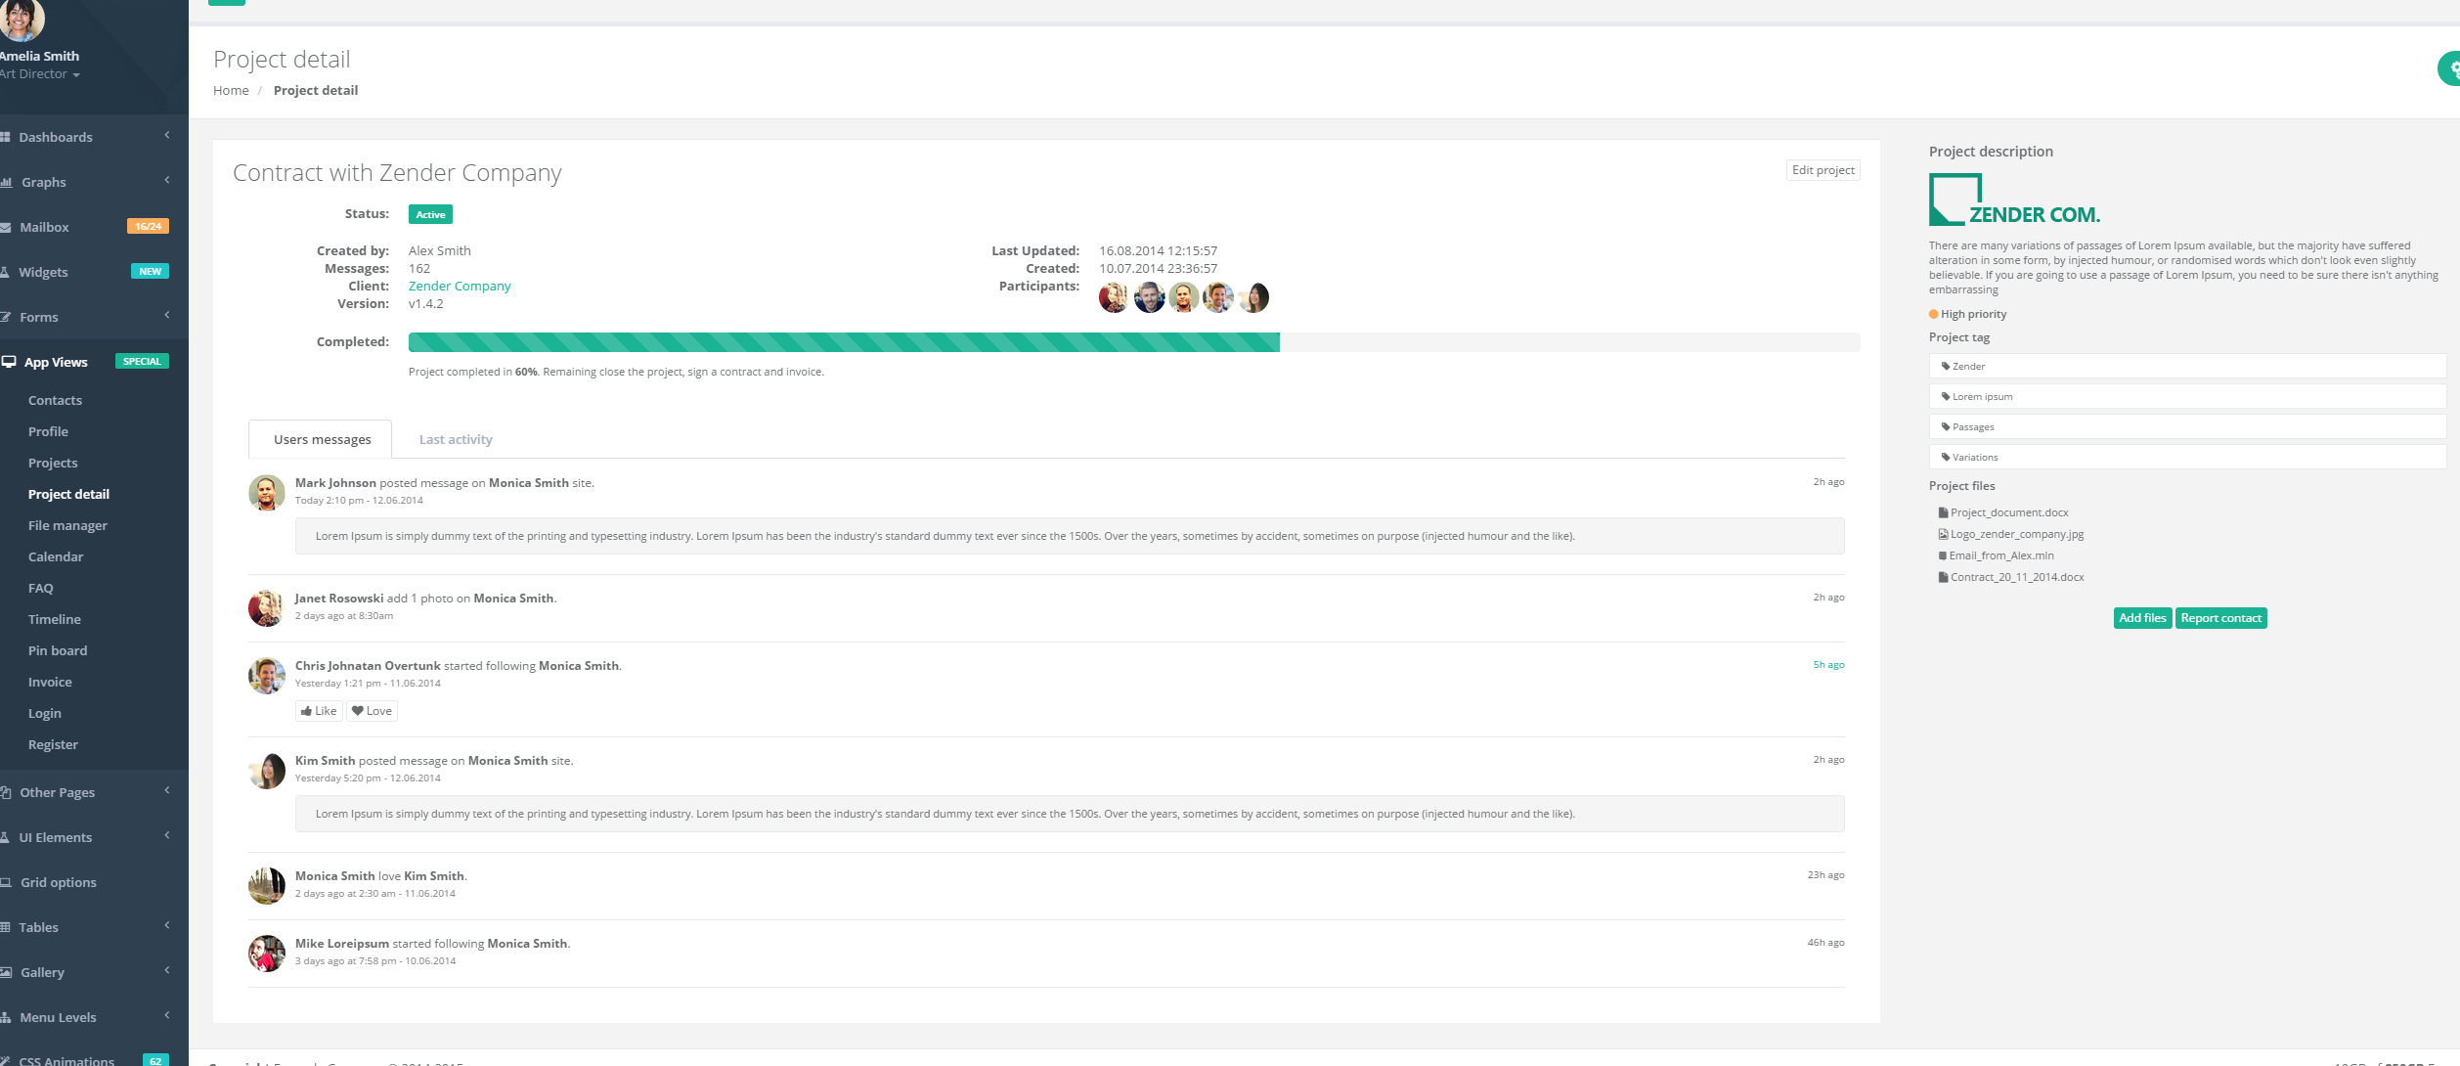

Slide 18
Copy
Attachments

